Slide 1
Welcome to the NHS Community

Slide 2
Topics
Bell Schedules
Extracurricular Activities
Courses in Grade 9
School Website/Power School Public Portal/School Cash Online
Cell Phone/Electronics and BYOD
Reporting periods and exams
Absence, notes, excuses
Healthy Habits

Slide 3
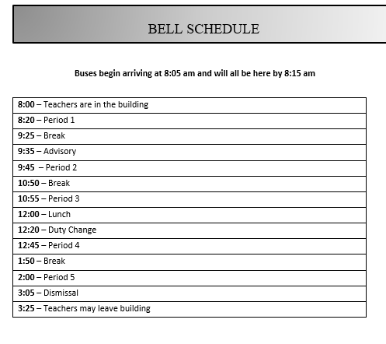

Slide 4
School Website nhs.nbed.ca
Public Powerschool Portal
School Cash Online
School Messenger
Student Handbook
Events at the school
Cool Nighthawk Swag
Nackawic Senior High School (nbed.ca.)

Slide 6
Required Grade 9 Courses
English 9 (A & B Full Year)
Math 9 (A & B Full Year)
Health and PhysEd 9 (1 semester)
French 9 (1 semester)
Social Studies 9 (1 semester)
Science 9 (1 semester)
Art 9, Music 9, Tech 9, Personal Wellness 9

Slide 7
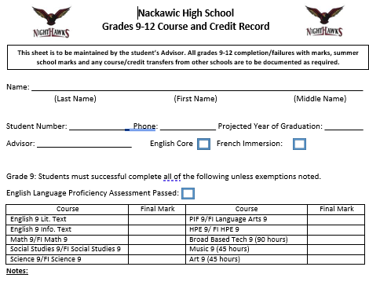

Slide 8
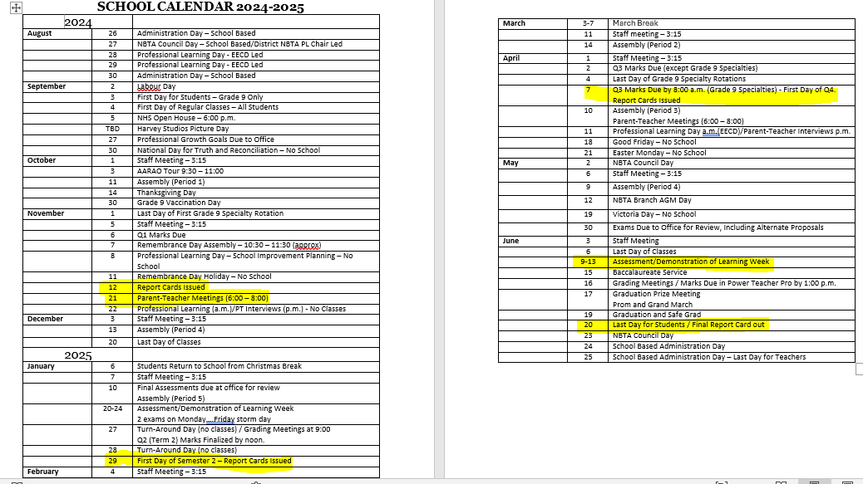

Slide 9
Coles Notes to the Cell Phone Policy

Slide 11
Electronic Device and BYOD Policy
https://www2.gnb.ca/content/gnb/en/services/services_renderer.201514.Laptop_Subsidy_Program.html

Slide 12
Increased Freedom

Slide 13
Healthy Habits Promote Success
Sleep
Screen time
Being Active/Be involved
Good study Habits and Time Management

Slide 14
Grade 9 Success in a Nutshell
Get involved!
Communicate with your teachers
Know about the new cell phone policy
Stay on top of classes
Lots of helpful things on school website and social media.
Managing freedom appropriately
Develop Healthy Habits

Slide 15
Questions?

