Slide 1
Technology Session
Nackawic High School

Slide 2
PowerSchool Portal
The PowerSchool Public Portal is an online tool that enables parents and students to become informed and involved partners in Education.
The Parent Portal gives Parents/Guardians student information such as:
• Current Grades
Attendance
• Student Schedules
• Graduation Requirements
• Historical Grades (Report Card grades)

Slide 3
Single Sign-on Setup:
PowerSchool’s Portal uses a single sign-on process for parents/guardians, which means you now have your own individual parent/guardian account, including your personal username and password.
• The Parent Portal’s internet address is: https://sisasde.nbed.nb.ca/public/home.html
• Create your parent account
• Link children to your account using the Student Access ID & Password
• You can also add a student to an existing parent/guardian account

Slide 4
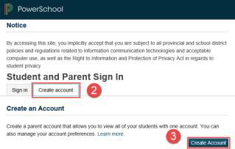
Create an Account
Follow these steps to create an account for the Public Portal and Link your child(ren) to your account:
1. Enter the website address into your browser (e.g. Google Chrome, Internet Explorer, Firefox etc.)
2. Click on Create account tab.
3. Click Create Account button.

Slide 5
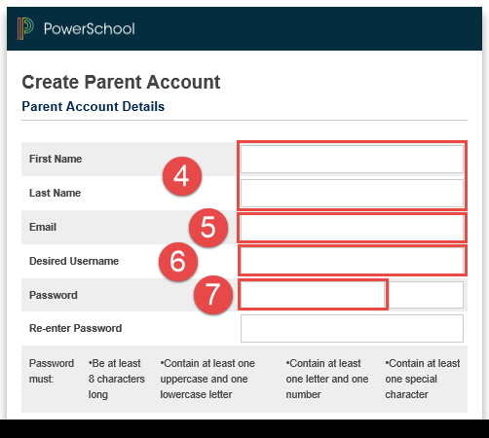
4. Enter your first and last name.
5. Enter your email address. This is the email address that all notices from the school are sent. PLEASE NOTE: You must enter a valid email address to create an account.
6. Enter a user name of your choice, which you will use each time you SignIn to the Parent Portal.
7. Create a password

Slide 6
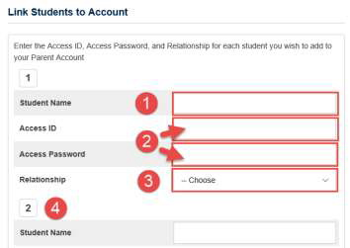
Linking Your Children to Your Parent Account
1. Enter the name of your child exactly as it is printed on the letter from the school. Each child should be setup individually.
2. Enter the Student Access ID and Access Password for your child, as per the letter from the school.
3. Select your relationship to the child from the drop-down list.
4. If you have more than one child, repeat steps 1 to 3 for the next child in the next section. Select Enter.

Slide 7
NHS Electronic Device and BYOD Policy
Rules & Guidelines

Slide 8
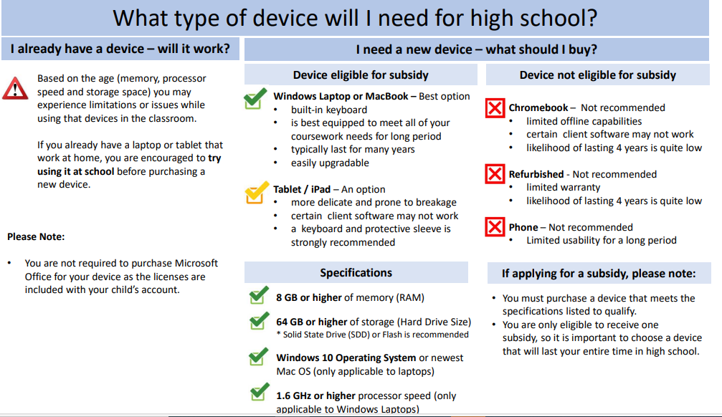
https://www2.gnb.ca/content/dam/gnb/Departments/ed/pdf/K12/AppendixTechnicalSpecifications.pdf

Slide 9
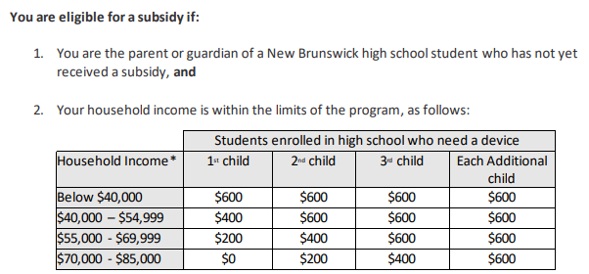
Laptop Subsidy Program
Eligible families can apply through the Online Parent Portal https://www.nbed.nb.ca/parentportal/

Slide 10
Additional Resources
-Payment Plan Options
-Nelly Freddy https://m.facebook.com/100092123294916/
-If you are ineligible to receive a subsidy but would like to take advantage of a discounted price (less than $600 taxes included) for the Dell Latitude 3400 Series laptop, you may still buy it through IMP Solutions: https://eecdsd-edpeae.impsolutions.com

